Slide 1
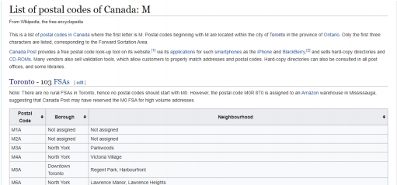
The Battle of Neighbourhoods
Raj
Introduction
Toronto is the capital city of the Canadian province of Ontario. With a recorded
population of 2,731,571 in 2016, it is the most populous city in Canada and the fourth most
populous city in North America. The city is the anchor of the Golden Horseshoe, an urban
agglomeration of 9,245,438 people (as of 2016) surrounding the western end of Lake
Ontario,[18] while the Greater Toronto Area (GTA) proper had a 2016 population of 6,417,516.
Toronto is an international centre of business, finance, arts, and culture, and is recognized as
one of the most multicultural and cosmopolitan cities in the world.
The objective of this project is to use Foursquare location data and regional clustering of venue
information to determine what might be the ‘best’ neighbourhoods in Toronto to open a Yoga
Studio. In recent years, yoga has become most popular way to stay healthy.
Target Audience
Yoga trainers and individuals who is willing to open a yoga studio.
Data Overview
The data that will be required will be a combination of CSV files that have been
prepared for the purposes of the analysis from multiple sources which will provide the list of
neighbourhoods in Toronto (via Wikipedia), the Geographical location of the neighbourhoods
(via Geocoder package) and Venue data pertaining to Yoga studio(via Foursquare). The Venue
data will help find which neighbourhoods is best suitable to open a Yoga Studio.
Methodology
1. Extract the data from the data sources.
Figure 1:Wikipedia Page showing List of Neighbourhoods in Toronto with respective Postal
Codes

Slide 2
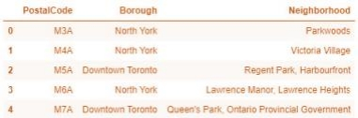
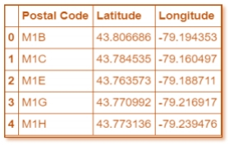
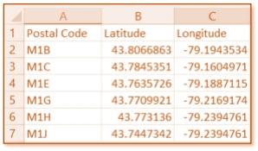
The Wikipedia site ( https://en.wikipedia.org/wiki/List_of_postal_codes_of_Canada:_M )
shown above, provided almost all the information about the neighbourhoods. It included the
postal code, borough and the name of the neighbourhoods present in Toronto. Since the data is
not in a format that is suitable for analysis, scraping of the data was done from this site (shown
in figure2).
Figure 2: Data that was scraped from Wikipedia site and put into Pandas data frame
Figure 3: Geogaphical data of Neighborhoods in Toronto
Figure 4: Conversion of file into Pandas data frame

Slide 3
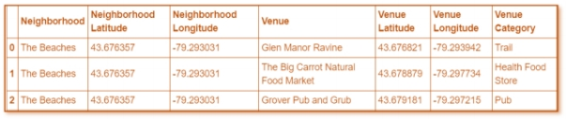
The second source of data provided ( https://cocl.us/Geospatial_data ) us with the
Geographical coordinates of the neighborhoods with the respective Postal Codes. The file was
in CSV format, so attaching it to a Pandas data frame was simple (shown in figure 3).
The retrieval of the location, name and category about the various venues in Toronto
was collected through the Foursquare explore API. To obtain the data, it was required to make
an account where it would provide a ‘ Secret Key ’ as well as a ‘Client ID ’ which would allow
to pull any data.
Figure 5: Venue data pull from Foursquare explore API Data
It is seen through figure 5 (above) that the neighborhoods are grouped by the neighborhood, so
data clustering is made easier later on.
Subsequently, all the data was collected and put into data frames, cleansing, and merging of
the data was required to start the process of analysis. When getting the data from Wikipedia,
there were Boroughs that were not assigned to any neighbourhoods therefore, the following
assumptions were made:
1. Only the cells that have an assigned borough will be processed. Borough that is not
assigned are ignored.
2. More than one neighbourhood can exist in one postal code area. For example, in the
table on the Wikipedia page, you will notice that M5A is listed twice and has two
neighbourhoods: Harbourfront and Regent Park. These two rows will be combined into
one row with the neighbourhoods separated with a comma as shown in Figure2 row 4.
3. If a cell has a borough but a Not assigned neighbourhoods, then the neighbourhoods will be
the same as the borough.
After the implementation of the following assumptions, the rows were grouped based on
borough as shown below.

Slide 4
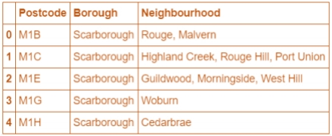
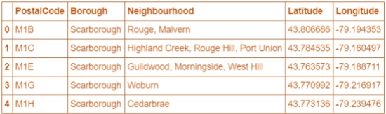
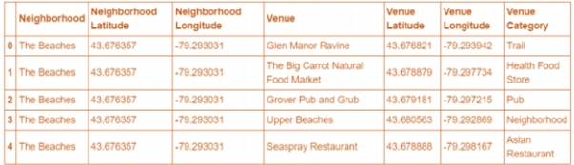
Figure 6: Rows grouped together based on Borough
Using the Latitude and Longitude collected from the Geocoder package, we merged the two
tables together based on Postal Code.
Figure 7: Merging tables together based on Postal Code
After, the venue data pulled from the Foursquare API was merged with the table above
providing us with the local venue within a 500-meter radius shown below.
Figure 8: Local Venues near the respective Neighbourhood
Now after cleansing the data, the next step was to analyse it. We then created a map using
folium and colour coded each Neighbourhood depending on what Borough it was located in.

Slide 5
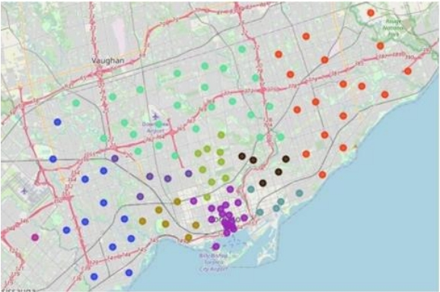
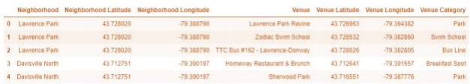
Figure 9: Toronto Neighborhoods
Next, we used the Foursquare API to get a list of all the Venues in Toronto which included
Parks, Schools, Café Shops, Asian Restaurants etc. Getting this data was crucial to analyzing
the number of Yoga Studios all over Toronto. There was not many Yoga Studios in Toronto.
We then merged the Foursquare Venue data with the Neighborhood data which then gave us
the nearest Venue for each of the Neighborhoods.
Figure 10: Venue table merged with neighbourhood data
Then to analyse the data we performed a technique in which Categorical Data is transformed
into Numerical Data for Machine Learning algorithms. This technique is called One hot
encoding. For each of the neighbourhoods, individual venues were turned into the frequency
at how many of those Venues were located in each neighbourhood.

Slide 6
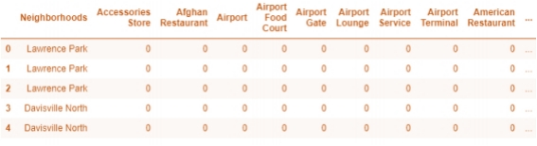
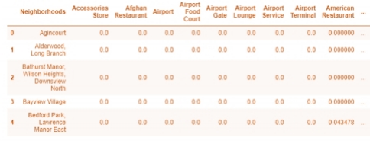
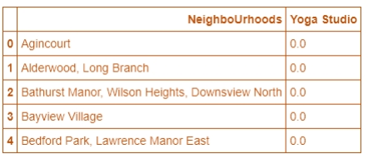
Figure 11: One Hot Encoding
Then we grouped those rows by Neighbourhood and by taking the Average of the frequency
of occurrence of each Venue Category.
Figure 12: Grouped Neighbourhoods by the average of the frequency of each Venue
After, we created a new data frame which only stored the Neighbourhood names as well as the
mean frequency of Yoga Studios in that Neighbourhood. This allowed the data to be
summarized based on each individual Neighbourhood and made the data much simpler to
analyse.
Figure 13: New data frame storing Neighbourhoods and the average Italian Restaurant in
that Neighbourhood

Slide 7
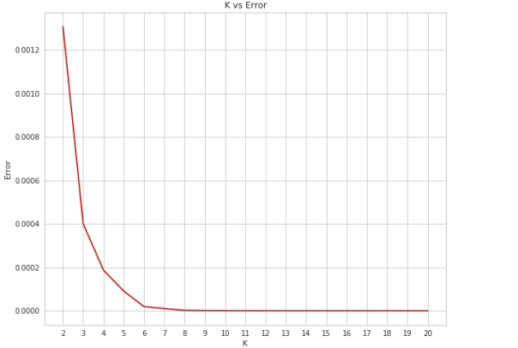
To make the analysis more interesting, we wanted to cluster the neighbourhoods based on the
neighbourhoods that had similar averages of Yoga Studio in that Neighbourhood. To do this
we used K-Means clustering. To get our optimum K value that was neither overfitting or
underfitting the model, we used the Elbow Point Technique. In this technique we ran a test
with different number of K values and measured the accuracy and then chose the best K
value. The best K value is chosen at the point in which the line has a sharpest turn. In our
case we had the Elbow Point at K = 4. That means we will have a total of 4 clusters.
Figure 14: Finding the K vs Error Values
We integrated a model which would fit the error and calculate the distortion score. From the
dotted line, we see that the Elbow is at K=4. Moreover, in K-Means clustering, objects that
are similar based on a certain variable are put into the same cluster. Neighbourhoods that had
similar mean frequency of Yoga Studio were divided into 4 clusters. Each of these clusters
were labelled from 0 to 3 as the indexing of labels begin with 0 instead of 1.

Slide 8
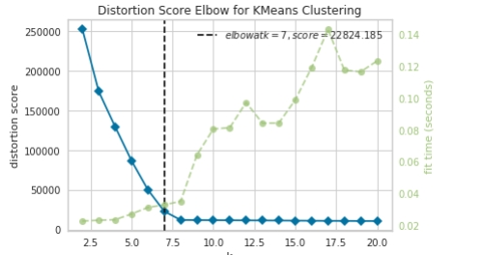
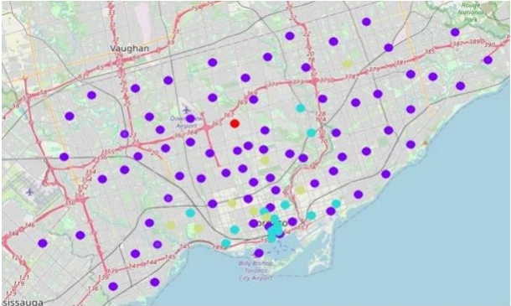
Figure 15: Finding the right K using Elbow point
After, we merged the venue data with the table above creating a new table which would
be the basis for analysing new opportunities for opening a new Italian Restaurant in Toronto.
Then we created a map using the Folium package in Python and each neighborhood was
coloured based on the cluster label. For example, cluster 2 was purple and cluster 3 was blue.
Figure 16 Map with different clusters

Slide 9
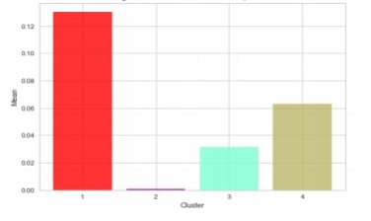
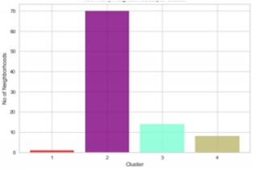
Analysis:
We have a total of 4 clusters (0,1,2,3). Before we analyse them one by one let’s check the
total amount of neighbourhoods in each cluster and the average Yoga Studio in that cluster.
From the bar graph that was made using Matplotlib (figure 18) , we can compare the number
of Neighbourhoods per Cluster. We see that Cluster 1 has the least neighbourhood’s (1) while
cluster 2 has the most (70). Cluster 3 has 14 neighbourhood’s and cluster 4 has only 8. Then
we compared the average Yoga Studio per cluster.
Figure 19: Average Italian restaurant in each neighborhood
Figure 20: Number of neighbours per cluster
This information is crucial as we can see that even through there is only 1 neighbourhoods in
Cluster 1, it has the highest number of Yoga Studio (0.1304) while Cluster 2 has the most
neighbourhoods but has the least average of Yoga Studio (0.0009). The average of the
average Italian Restaurant made up the data for Figure 18. Also, from the map, we can see
that neighbourhoods in Cluster 2 are the most sparsely populated. Now let’s analyse the
Clusters individually (Note: these are just snippets of the data).

Slide 10
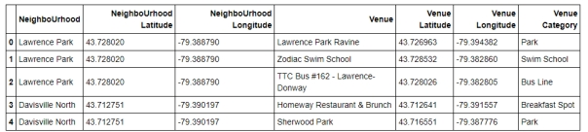
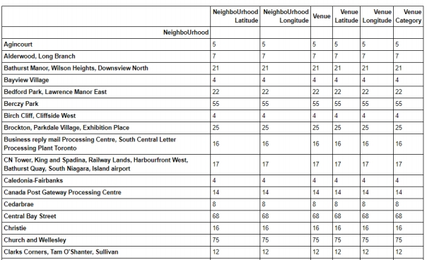
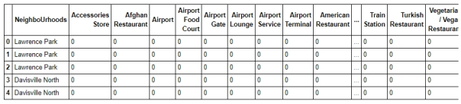

Slide 11
Discussion
Most of the Yoga Studio are in cluster 1 represented by the red clusters. The Neighbourhoods
located in the North York area that have the highest average of Yoga Studio are Bedford Park
and Lawrence Manor East. Even though there is a huge number of Neighbourhoods in cluster
2, there is little to no Italian Restaurant. We see that in the Downtown Toronto area (cluster 3)
has the second last average of Italian Restaurants. Looking at the nearby venues, the optimum
place to put a new Italian Restaurant is in Downtown Toronto as there are many
Neighbourhoods in the area but little to no Yoga Studio therefore, eliminating any competition.
The second-best Neighbourhoods that have a great opportunity would be in areas such as
Adelaide and King, Fairview, etc. which is in Cluster 2. Having 70 neighbourhoods in the area
with no Yoga Studio gives a good opportunity for opening a new restaurant. Some of the
drawback of this analysis are – the clustering is completely based on data obtained from
Foursquare API. Also, the analysis does not take into consideration of the Italian population
across neighbourhoods as this can play a huge factor while choosing which place to open a new
Italian restaurant. This concludes the optimal findings for this project and recommends the
entrepreneur to open an authentic Italian restaurant in these locations with little to no
competition.
Conclusion
In conclusion, to end off this project, we had an opportunity on a business problem, and it was
tackled in way that it was like how a genuine data scientist would do. We utilized numerous
Python libraries to fetch the information , to control the content and to break down and visualize
those datasets. We have utilized Foursquare API to investigate the settings in neighbourhoods
of Toronto, get great measure of data from Wikipedia which we scraped with the beautiful soup
Web scraping Library. We also visualized utilizing different plots present in seaborn and
matplotlib libraries. Similarly, we applied AI strategy to anticipate the error given the
information and utilized Folium to picture it on a map. Places that have room for improvement
or certain drawbacks gives us that this project can be additionally improved with the assistance
of more information and distinctive Machine. Learning strategies. Additionally, we can utilize
this venture to investigate any situation, for example, opening an alternate cuisine or opening
of a Movie Theatre and so forth. Ideally, this task acts as an initial direction to tackle more
complex real-life problems using data-science.

